Slide 1
CONTAINMENT (HAS-A RELATIONSHIP)
STACK
CB obj1
CB obj2
CA *p
CA *p
&&
&&
CB obj1(10,20);
CB obj2(30,40);
HEAP
CA::a
10
CA::a
30
CA::b
20
CA::b
40
CA
CA

Slide 2
SHALLOW COPY
STACK
CB obj1
CB obj2
CA *p
CA *p
Shallow
copy
&&
&&
CB obj2(obj1);
compiler synthesized
copy constructor
CB(const CB &x):p(x.p) {..}
HEAP
CA::a
10
CA::b
20
CA

Slide 3
SHALLOW ASSIGNMENT
STACK
CB obj3
CB obj4
CA *p
CA *p
CB obj3(40,50), obj4;
Obj4 = obj3;
compiler synthesized
Assignment function
void operator =(const CB &x)
{
p = x.p;
}
Shallow
assignment
&&
&&
X
HEAP
CA::a
40
CA::a
0
CA::b
50
CA::b
0
CA
CA
LEAKED MEMORY

Slide 4
DEEP COPY
STACK
CB obj2(obj1);
Custom copy constructor
CB(const CB &x)
{
p = new(nothrow) CA(*(x.p));
}
CB obj1
CB obj2
CA *p
CA *p
&&
&&
HEAP
CA::a
10
deep
copy
CA::a
10
CA::b
20
CA::b
20
CA
CA

Slide 5
DEEP ASSIGNMENT
STACK
CB obj3
CB obj4
CA *p
CA *p
CB obj3(40,50), obj4;
Obj4 = obj3;
Custom Assignment function
void operator =(const CB &x)
{
*(this->p) = *(x.p);
}
&&
&&
HEAP
CA::a
40
deep
assignment
CA::a
40
CA::b
50
CA::b
50
CA
CA

Slide 6
SINGLE LEVEL INHERITANCE
Base
class
class CA
{
//……………….
};
class CB: public CA
{
//……………
};
CA
Derived
class
CB

Slide 7
MULTI-LEVEL INHERITANCE
class CA
{
//……………….
};
class CB: public CA
{
//……………
};
class CC: public CB
{
//……………
};
class CD: public CC
{
//……………
};
CA
CB
CC
CD

Slide 8
ONE-TO-MANY INHERITANCE
class CA
{
//……………….
};
class CB: public CA
{
//……………
};
class CC: public CA
{
//……………
};
class CD: public CA
{
//……………
};
CA
CB
CC
CD

Slide 9
MANY-TO-ONE (MULTIPLE) INHERITANCE
class CA
{
//……………….
};
class CB
{
//……………
};
class CC
{
//……………
};
class CD: public CA,public CB, public CC
{
//……………
};
CA
CB
CC
CD

Slide 10
HYBRID INHERITANCE (Dreaded Diamond)
class CA
{
//……………….
};
class CB:public CA
{
//……………
};
class CC:public CA
{
//……………
};
class CD: public CB, public CC
{
//……………
};
CA
CB
CC
CD

Slide 11
INHERITANCE & ACCESS SPECIFIERS
CA
PRIVATE
PROTECTED
PUBLIC
PRIVATE
PROTECTED
PUBLIC
CB
PRIVATE
PROTECTED
PUBLIC
class CB:private CA
{….}
CB
PRIVATE
PROTECTED
PUBLIC
class CB:protected CA
{….}
PRIVATE INHERITANCE
CB
PROTECTED INHERITANCE
class CB:public CA
{….}
PUBLIC INHERITANCE

Slide 12
OBJECT LAYOUT
class CA //BASE CLASS
{
private:
int a,b;
public:
//...
};
class CB:public CA //DERIVED CLASS
{
private:
int a,b;
public:
//....
};
CA::a
CA::b
CA OBJECT LAYOUT
Sub object
CA::a
CA::b
CB::a
CB::b
CB OBJECT LAYOUT

Slide 13
HYBRID INHERITANCE
class CA //BASE CLASS
{ private: int a;
public: //...
};
class CB:public CA
{
private: int b;
public: //...
};
class CC:public CA
{
private: int c;
public: //...
};
class CD:public CB, public CC
{
private: int d;
public: //...
};
CA
CA::a
CB
CC
CA::a
CB::b
CC:c
CB OBJECT LAYOUT
CD
CC OBJECT LAYOUT
CA::a
CB::b
CA::a
CC:c
CD::d
CD OBJECT LAYOUT

Slide 14
VIRTUAL INHERITANCE
class CA //BASE CLASS
{ private: int a;
public: //...
};
class CB: virtual public CA
{
private: int b;
public: //...
};
class CC: virtual public CA
{
private: int c;
public: //...
};
class CD:public CB, public CC
{
private: int d;
public: //...
};
CA
ptr
ptr
CA::a
CB
CC
CA::a
CB::b
CC:c
CB OBJECT LAYOUT
CD
CC OBJECT LAYOUT
CA::a
ptr
CB::b
ptr
CC:c
CD::d
CA::a
CD OBJECT LAYOUT

Slide 15
VIRTUAL TABLES & Late Binding
DATA SEGMENT
void circle::draw() { … }
circle::~circle() {…}
void rectangle::draw() { … }
rectangle::~rect() {…}
& circle::draw()
& circle::~circle()
& rectangle::draw()
& rectangle::~rect()
circle class VTABLE
rectangle class VTABLE
vptr radius
vptr radius length breadth
HEAP
Circle object
rectangle object
@@
##
##
##
@@
##
&&&
STACK
&&&
circle *p
circle *p

Slide 16
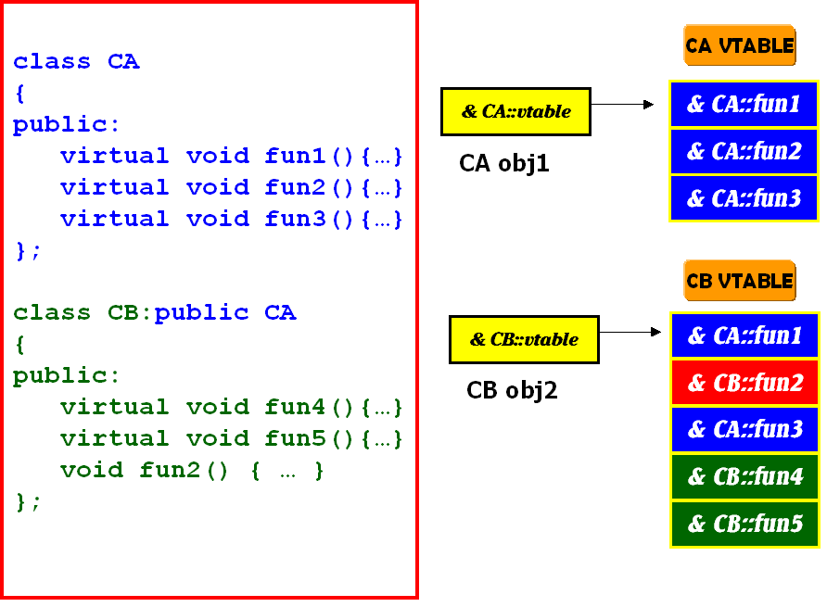
MULTI-LEVEL INHERITANCE & VTABLE LAYOUT

Slide 17
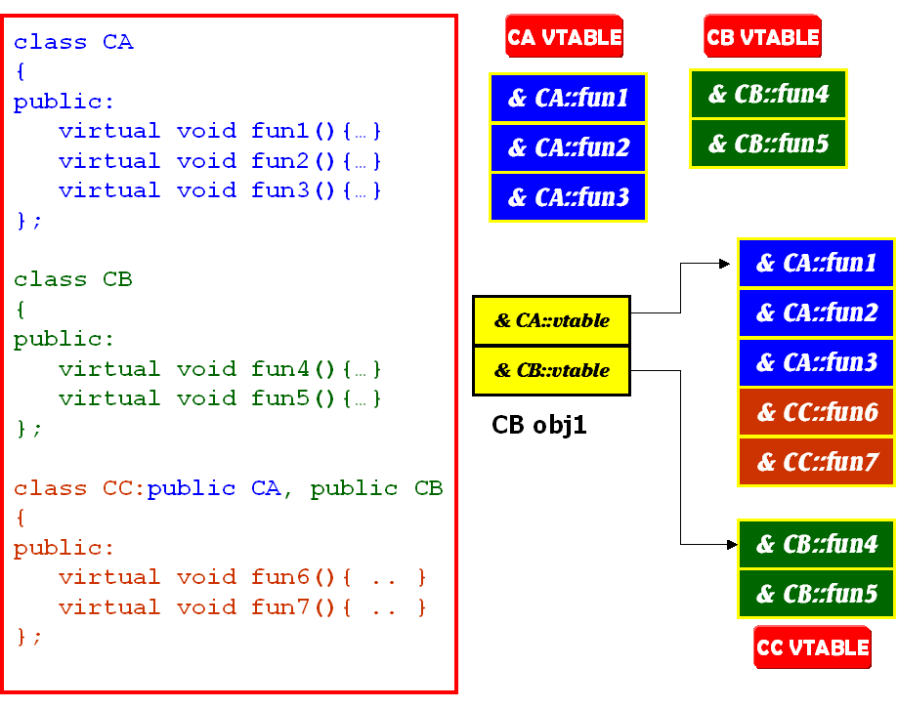
MULTIPLE INHERITANCE & VTABLE LAYOUT
CC obj1

Slide 18
RTTI TABLES
VTABLE
OBJECT
LOCATOR
CLASS
HIERARCHY
& RTTI OBJECT
LOCATOR
-1
0
0
0
1
1
2
COUNT
(RTTI BASE CLASS ARRAY)
2
& TYPE DESCRIPTOR
& RTTI BASE CLASS ARRAY
3
3
& CLASS HIERARCHY
DESCRIPTOR
4
& RTTI BASE CLASS DESCPR.
BASE CLASS
ARRAY
CONST TYPEINFO &
& RTTI TYPE DESCRIPTOR
0
0
1
1
2
2
BASE CLASS
DESCRIPTOR
3
RTTI TYPE
DESCRIPTOR
4
5
6

